Slide 1
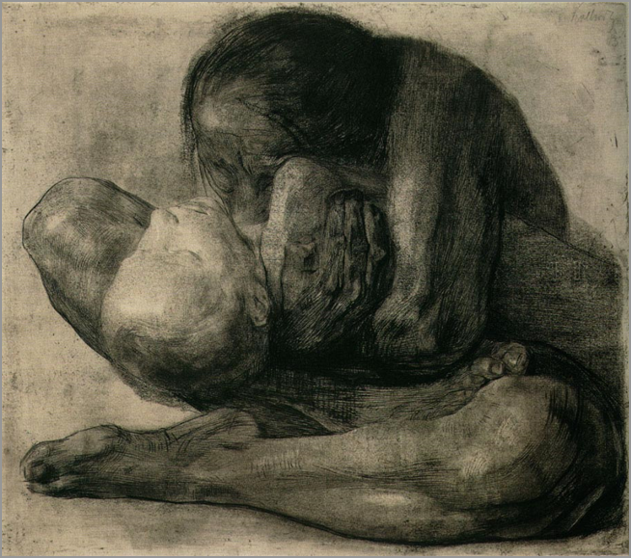
Expressionism in Germany Figurative and Abstract
Käthe Kollwitz (German 1867-1945), Woman with Dead Child, 1903

Slide 2
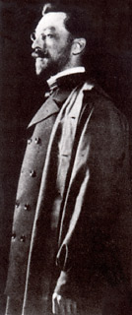
Wassily Kandinsky (Russian, active in Munich and Paris, 1866-1944) The artist is not born to a life of pleasure. He must not live idle; he has a hard work to perform, and one which often proves a cross to be borne. He must realize that his every deed, feeling, and thought are raw but sure material from which his work is to arise, that he is free in art but not in life....The artist is not only a king...because he has great power, but also because he has great duties. Wassily Kandinsky, "Conclusion" Concerning the Spiritual in Art, 1912
Kandinsky developed his theory and practice of abstract expressionist art between 1908 - 1911: three years.

Slide 3
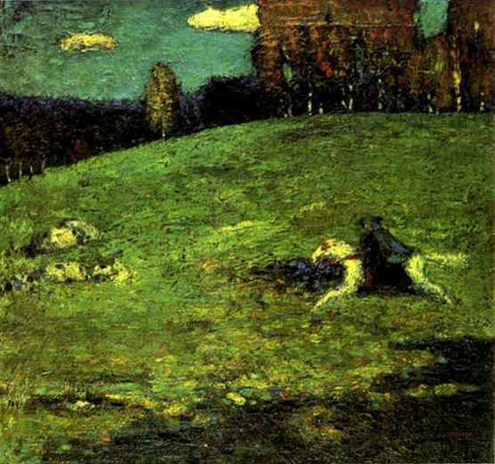
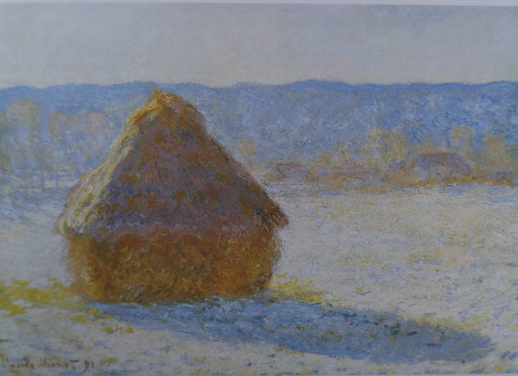
Wassily Kandinsky, The Blue Rider, oil on cardboard, 1903 Claude Monet, Haystack (Winter), 1891 The Blue Rider as symbol of the artist will recur and evolve according to the principles Kandinsky defines in his written texts, Concerning the Spiritual in Art and The Blue Rider Almanac.

Slide 4
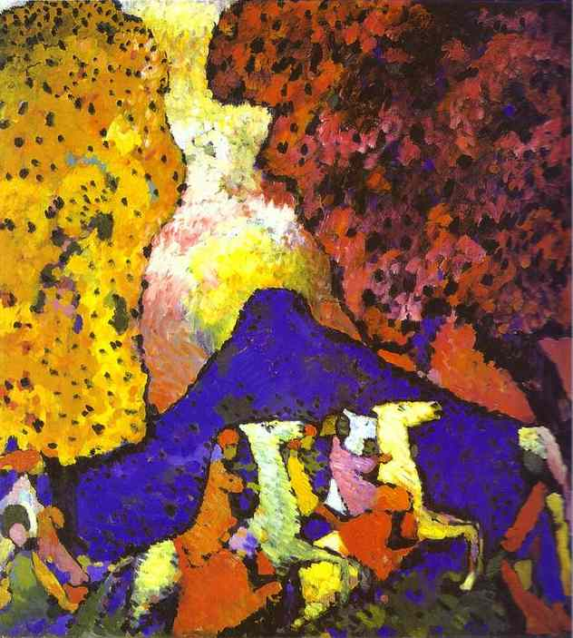
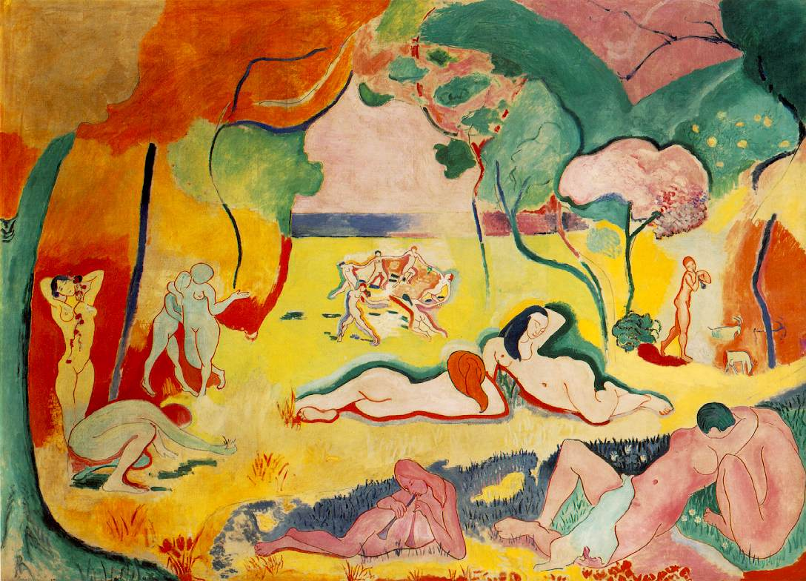
(left) Wassily Kandinsky, The Blue Mountain, 1908, o/c (right) Henri Matisse, The Joy of Life, 1906 Kandinsy’s Fauvist (style) symbolist landscapes

Slide 5
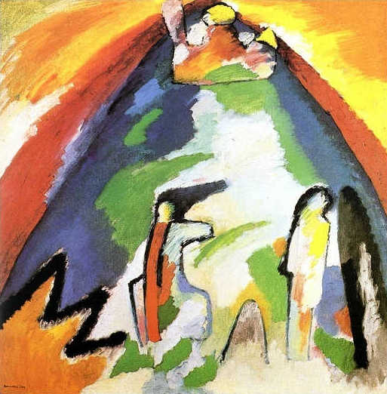
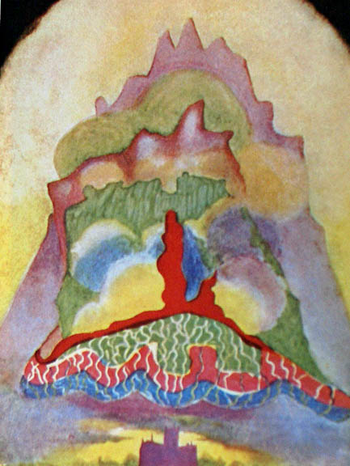
(right) Annie Besant and Charles Leadbeater (Theosophist), Thought-Form: Music of Wagner 1905, (left) Kandinsky, Mountain, 1908 Towards abstract painting

Slide 6
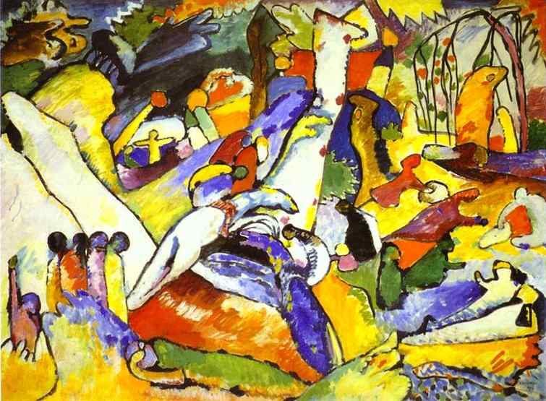
Wassily Kandinsky, Study for Composition 2, 1909-10, o/c, 38 x 51” Guggenheim, NYC. Based on Bible stories of the Deluge (Genesis) and Apocalypse (Revelations)

Slide 7
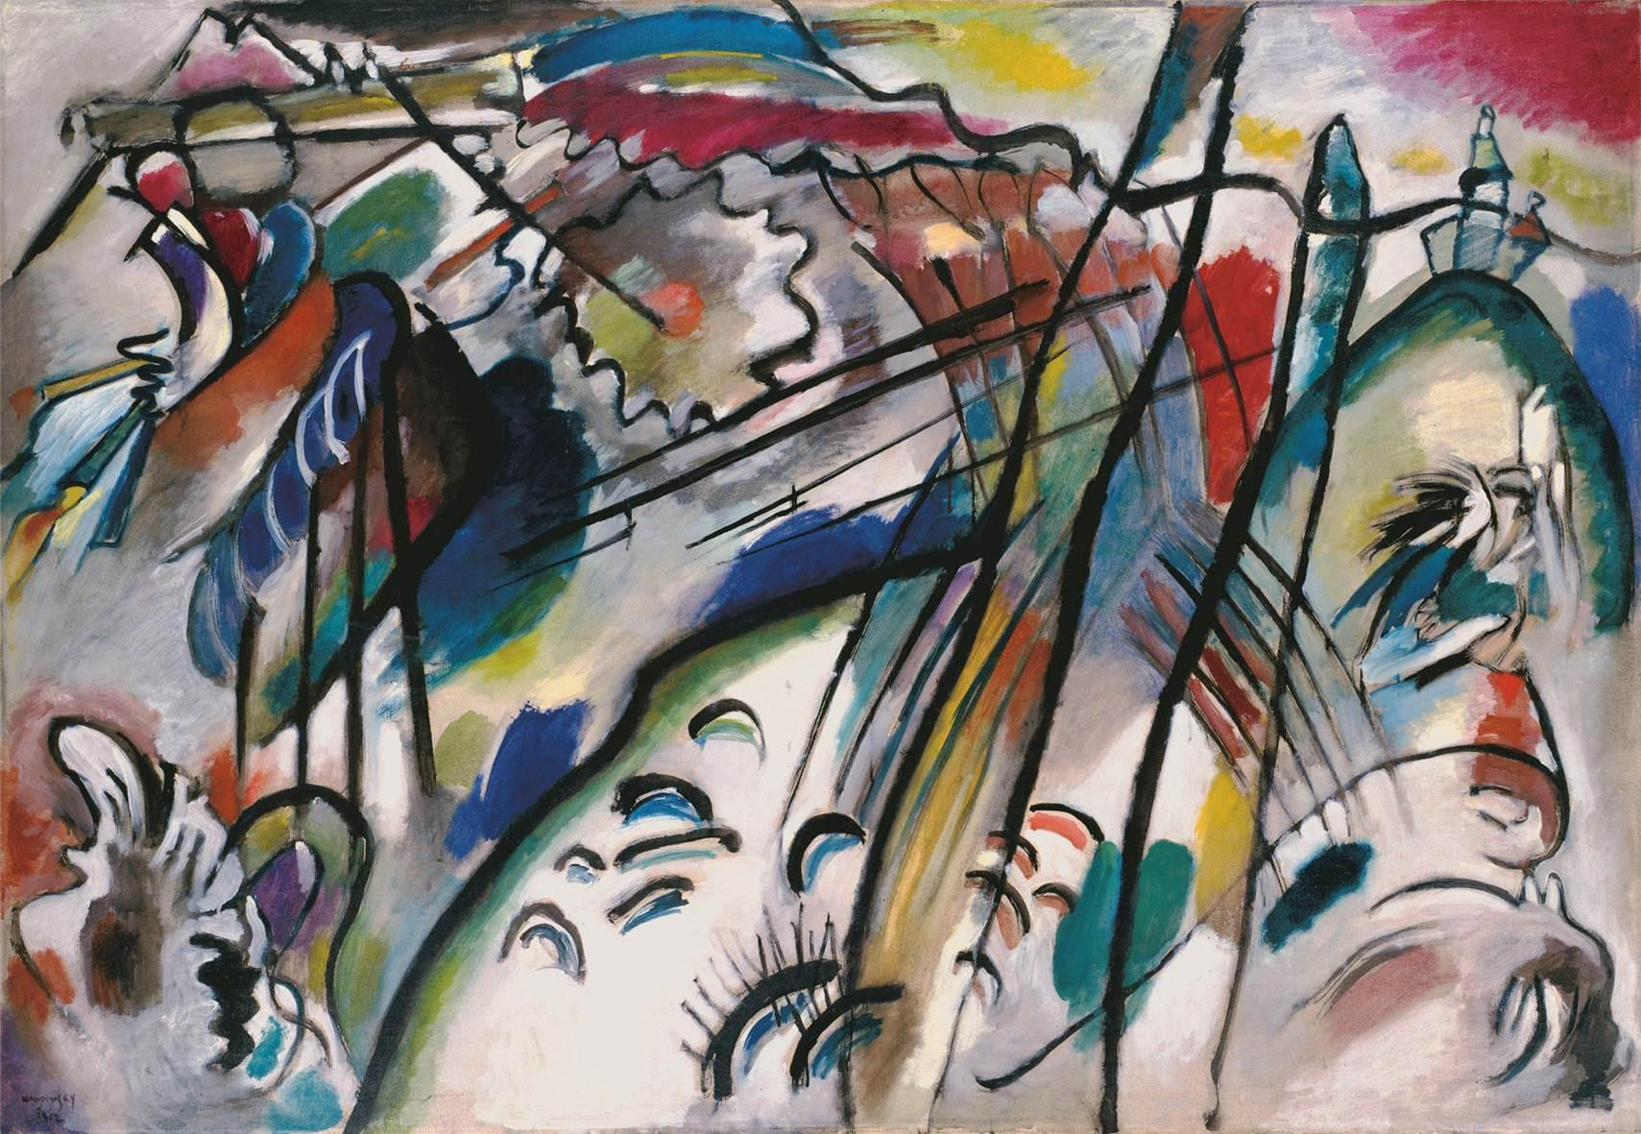
Vassily Kandinsky, Improvisation 28 (second version), 1912, oil on canvas, The new physics of early 20th century offered a new perception of matter, energy, and time that contributed to theories of abstraction over the mimetic representation of the world. Einstein published his theory of relativity E=mc² in 1916 and applied it to the universe in 1917.

Slide 8
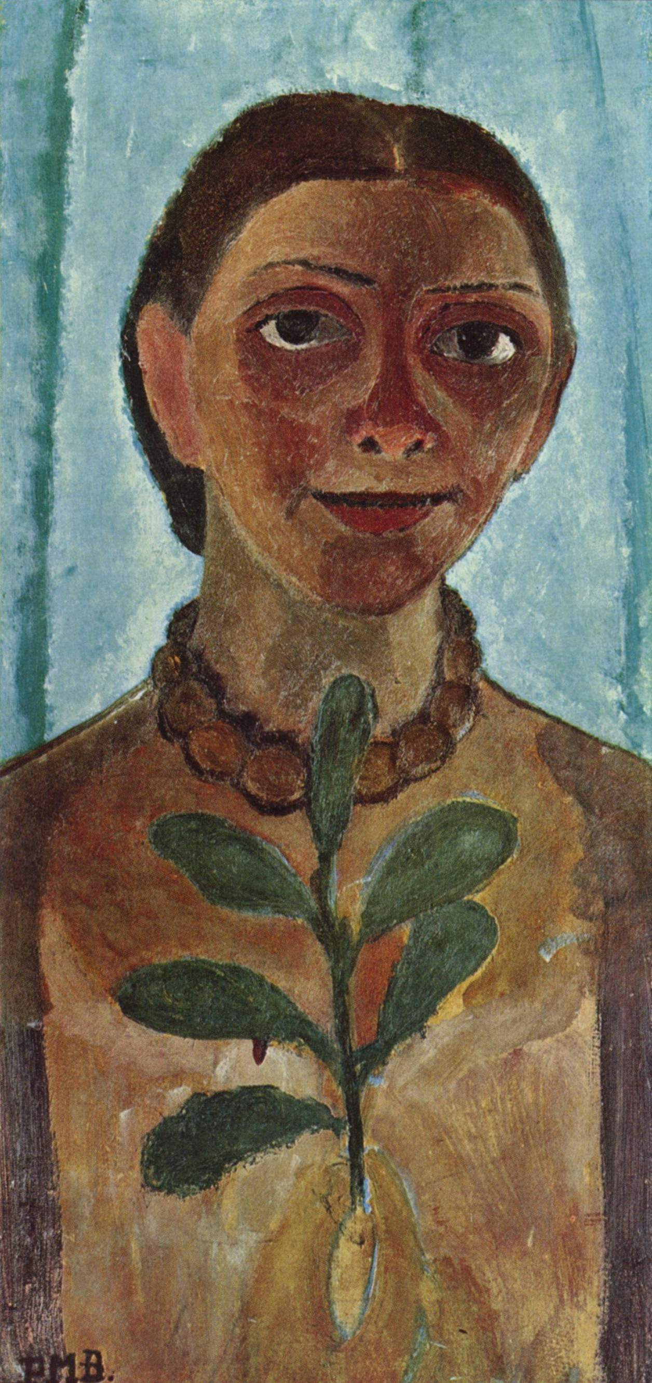
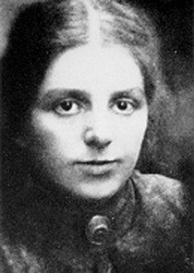
Paula Modersohn-Becker (German, 1876-1907: 31 years) from Post-Impressionism to Proto-Expressionism
Self Portrait, 1907, 62 × 31 cm

Slide 9
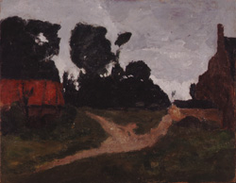
(left) Otto Modersohn, Moor Grasses, 1895 (right) Paula Modersohn-Becker, Red House, 1900 Worpswede, a rural German village and artist colony

Slide 10
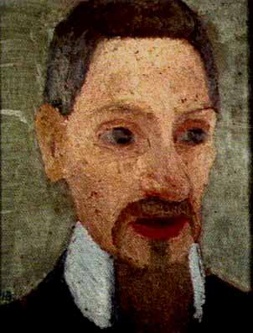
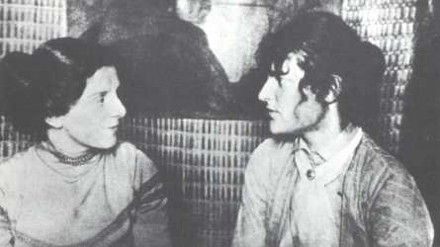
Paula Modersohn-Becker (left) with sculptor Clara Westhoff Becker spent 6 months in Paris 1900 where Westhoff was studying with Auguste Rodin and attending the Academie Colarossi (right) Modersohn-Becker, portrait of the poet, Rainer Maria Rilke, 1906

Slide 11
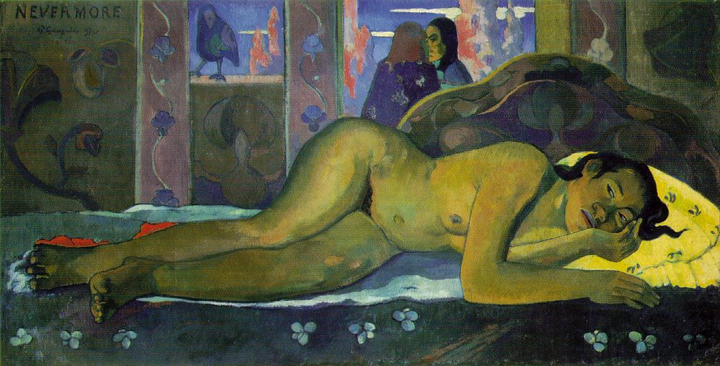
Modersohn-Becker, Reclining Mother and Child, 1906 (lower right) Paul Gauguin, Nevermore, 1897

Slide 12
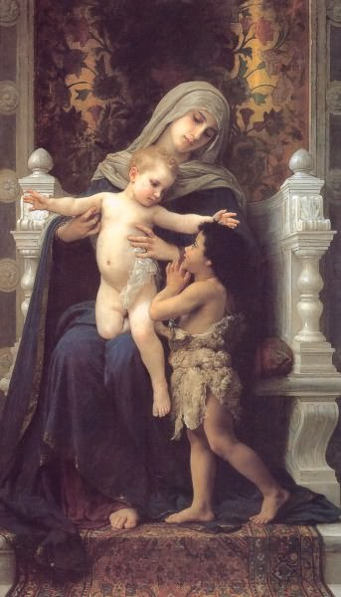
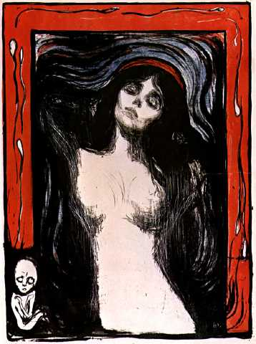
(left) William Bouguereau, Madonna and Child with Saint John the Baptist c. 1890. (right) Paula Modersohn-Becker, Reclining Mother and Child, 1906
Edvard Munch
Madonna, lithograph
1895

Slide 13
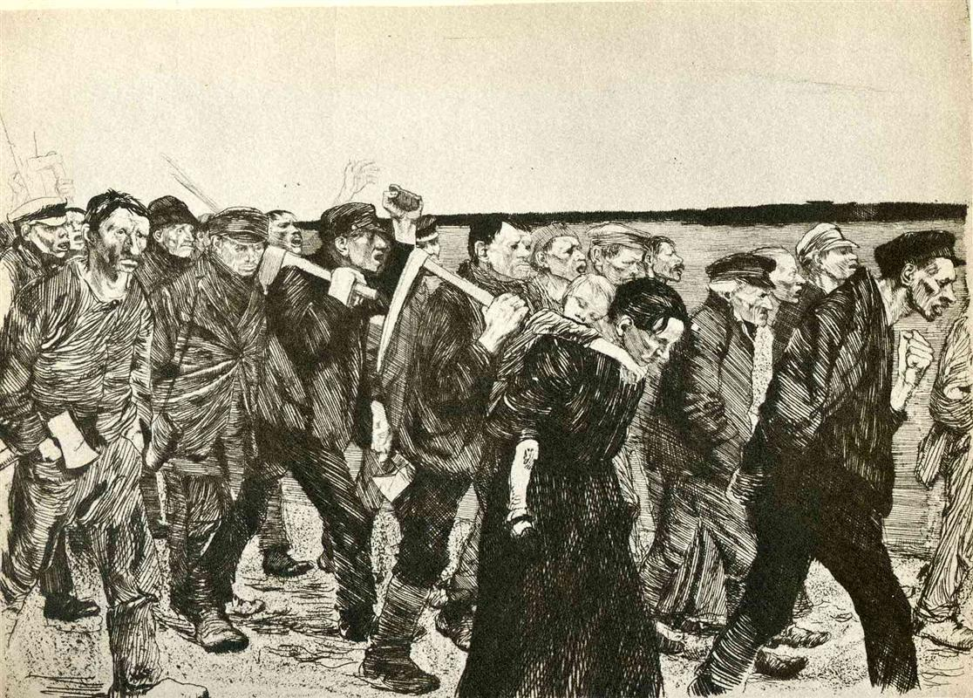
Käthe Kollwitz (1868-1945, German Expressionist printmaker and sculptor), The Weavers March to Berlin, etching with aquatint and sandpaper, 1897. Part of a series of etchings about the oppression of the Silesian weavers in Langenbielau and their failed revolt of 1844

Slide 14
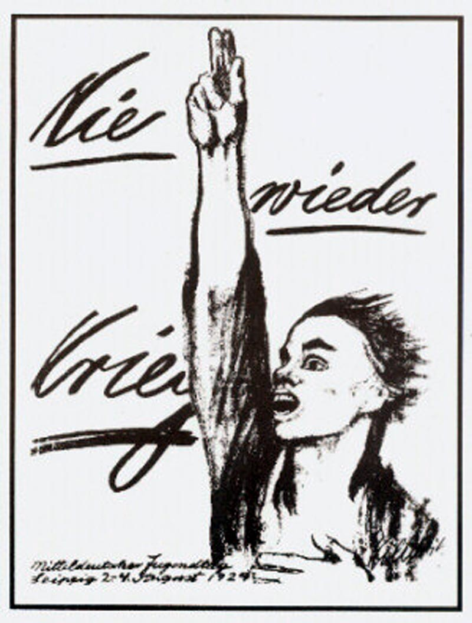
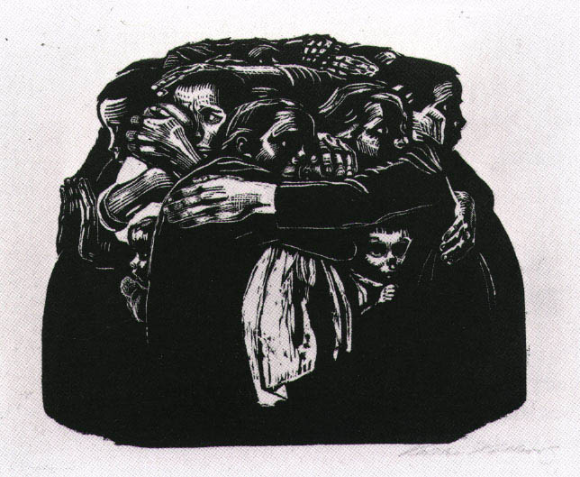
Käthe Kollwitz, Mothers (left), 1924; (right) Nie Wieder Kreig! (No More War!), litho poster for the Social Democratic Party, 1924

Slide 15
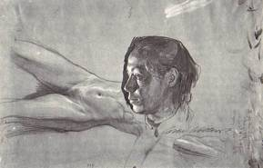
Käthe Kollwitz (German 1867-1945), Self Portrait and Nude Studies, 1900, graphite, pen and black ink. 280 x 445 cm. Stuttgart

Slide 16
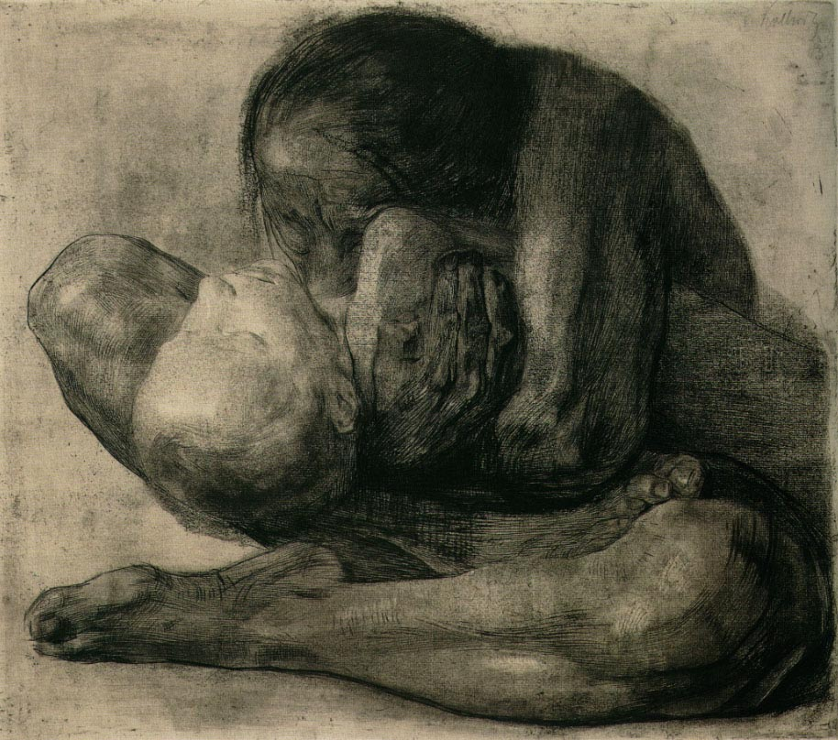
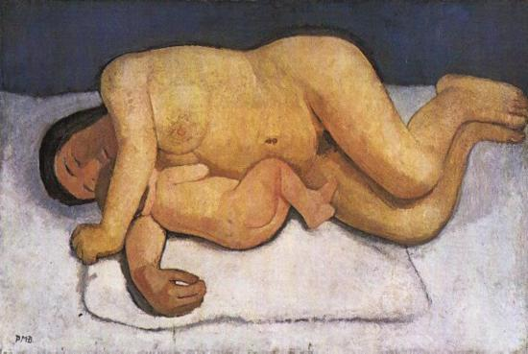
Käthe Kollwitz (German 1867-1945), Woman with Dead child, 1903, etching with engraving overprinted with a gold tone plate, 47.6 x 41.9 cm Paula Modersohn-Becker (German 1876-1907), Reclining Mother and Child, oil on canvas, 124.7 x 82 cm. 1906 (right)
The maternal nude was a new subject in the history of Western art
introduced by women artists to tell of a woman’s experience of body and life.

Slide 17
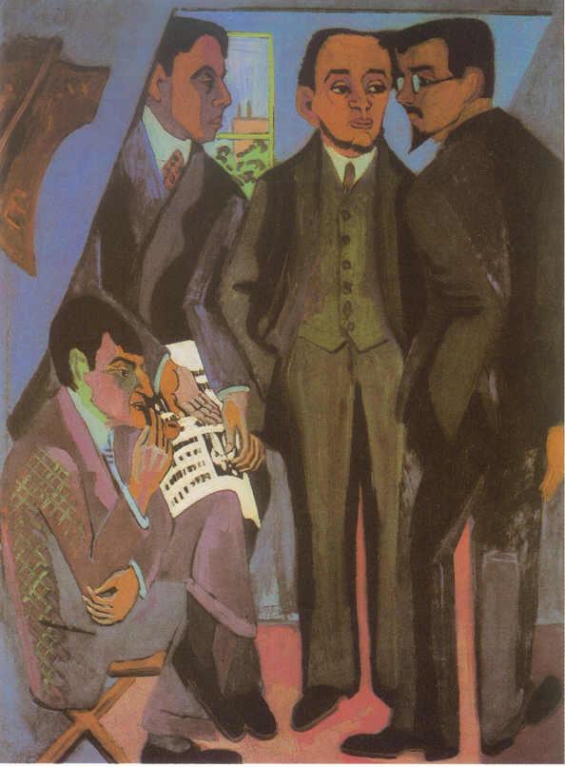
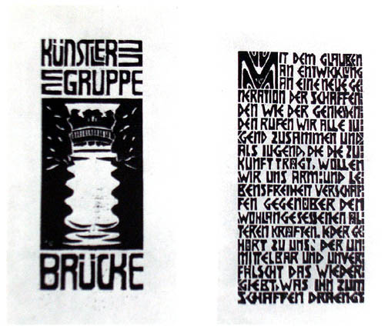
Die Brücke (The Bridge) Dresden Germany (left) Ernst Ludwig Kirchner (German, 1880-1938), The Painters of Die Brucke, 1925, o/c (L to R: Otto Muller, Ernst Ludwig Kirchner, Erich Heckel, Karl Schmidt-Rottluff (right) Manifesto of the Artists’ Group the Brücke, woodcuts “With faith in progress and in a new generation of creators and spectators we call together all youth. As youth, we carry the future and want to create for ourselves freedom of life and of movement against the long established older forces. Everyone who reproduces that which drives him to creation with directness and authenticity belongs to us."

Slide 18
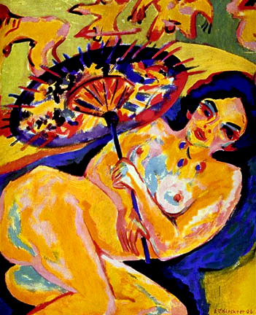
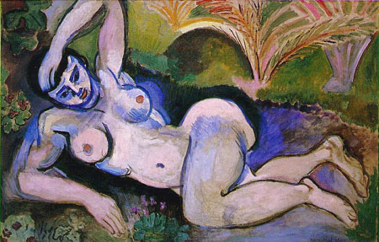
(left) Ernst Ludwig Kirchner, Girl With Japanese Parasol, 36 x 31 inches, oil on canvas, 1909 (Die Brücke, German Expresssionism) (right) Henri Matisse, Blue Nude: Souvenir of Biskra, o/c, 36 x 55 inches, 1907 (Fauve, French Expressionism) How is “expression” differently defined by these artists?

Slide 19
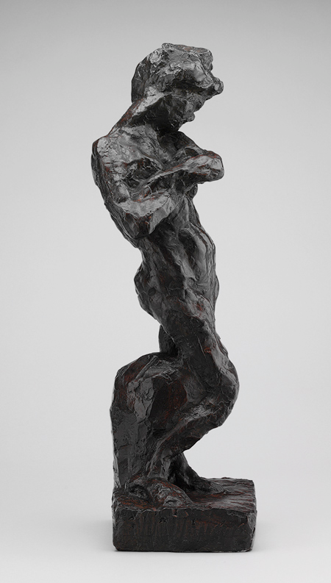
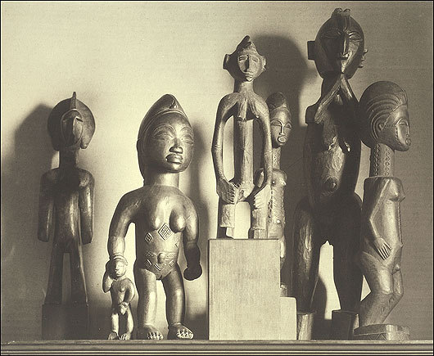
African pre-colonial sculptures (right) and (left) Henri Matisse, Madeline II, 1903, bronze Modern artists appropriated African art in the early 20th century with as much enthusiasm as they had earlier appropriated Japanese art

Slide 20
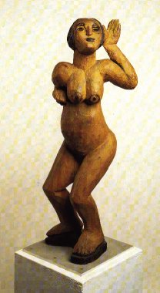
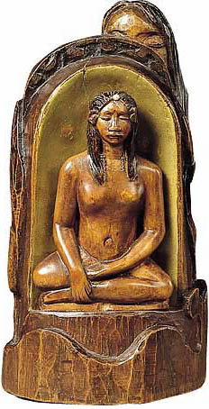
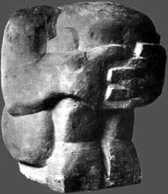
Ernst Ludwig Kirchner, Dancing Woman, 1911, wood polychromed (center) André Derain (French Fauve painter and sculptor, 1880-1954) Crouching Man, 1907, stone, 13 x 11” (right) Paul Gauguin, Idol, 1892, wood polychromed Expressionist Primitivism – French and German

Slide 21
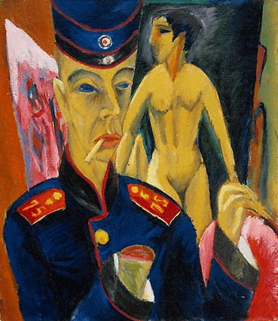
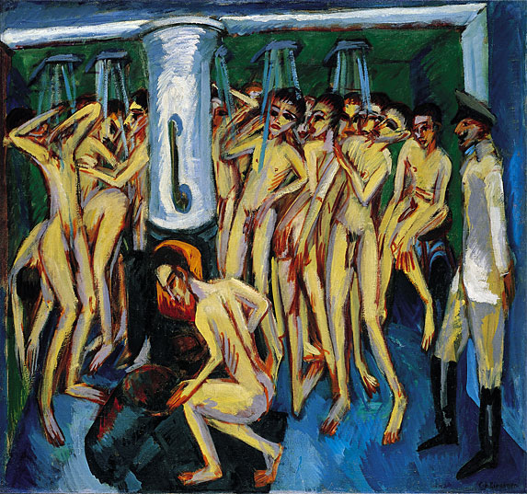
(left) Ernst Ludwig Kirchner, Self-Portrait as a Soldier, 1915 (right) Kirchner, The Soldier Bath (Artillerymen), 1915, oil on canvas, 55 x 59 inches

Slide 22
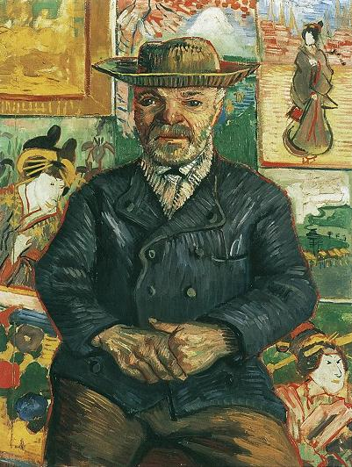
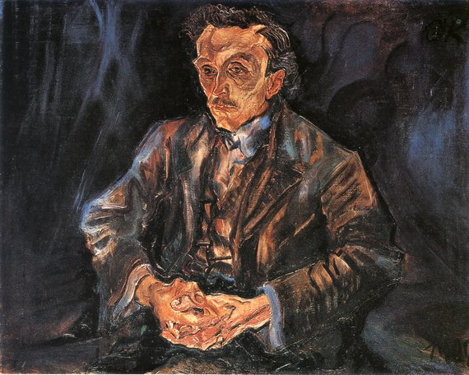
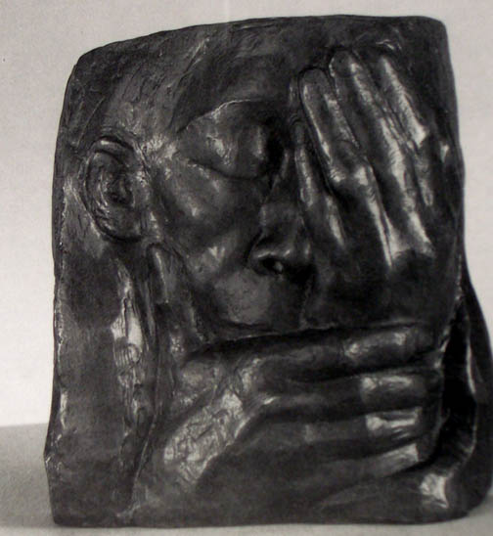
(left) Vincent Van Gogh, Père Tanguy, 1888 (center) Käthe Kollwitz, Lamentation: In Memory of Ernst Barlach (Grief), bronze, 1938 (right) Oskar Kokoschka, Adolf Loos, 1909

Slide 23
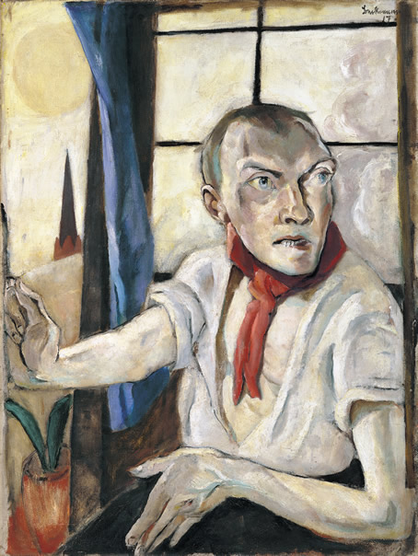
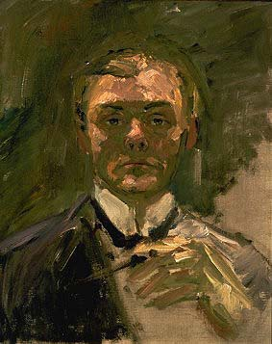
(left) Max Beckmann (German 1884 – 1950), Self Portrait with Raised Hand, 1907 / among 85 self-portraits (center) Beckmann, Self Portrait as Medical Orderly, 1915 (right) Beckmann, Self Portrait with Red Scarf, 1917
1915
1907
1917

Slide 24
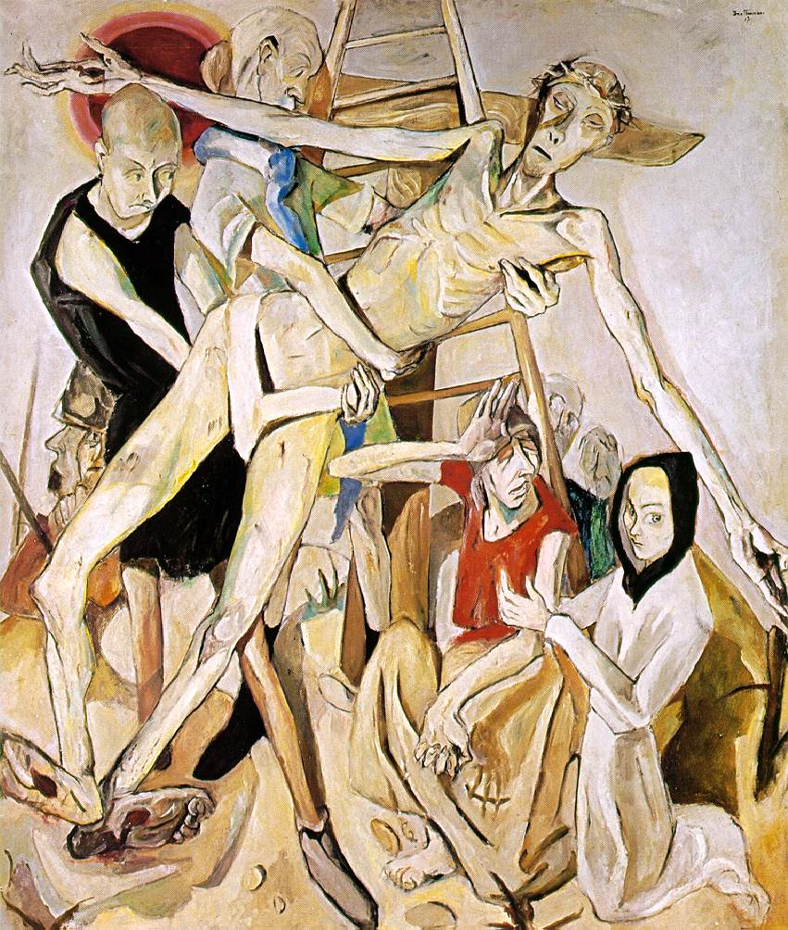
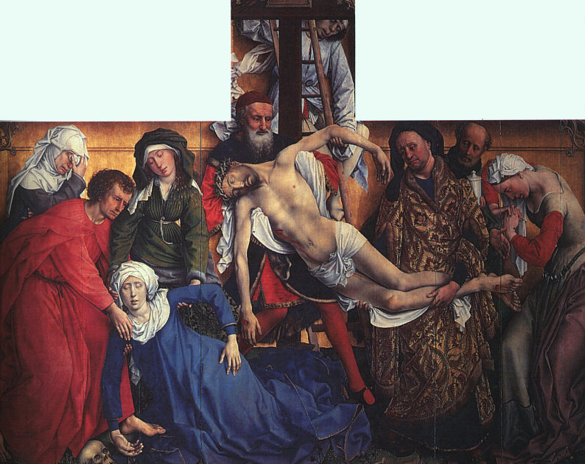
(left) Max Beckmann, Descent From the Cross, 1917 (right) Rogier Van Der Weyden (Netherlandish Northern Renaissance Painter, ca.1400-1464) Descent From the Cross, c. 1435

Slide 25
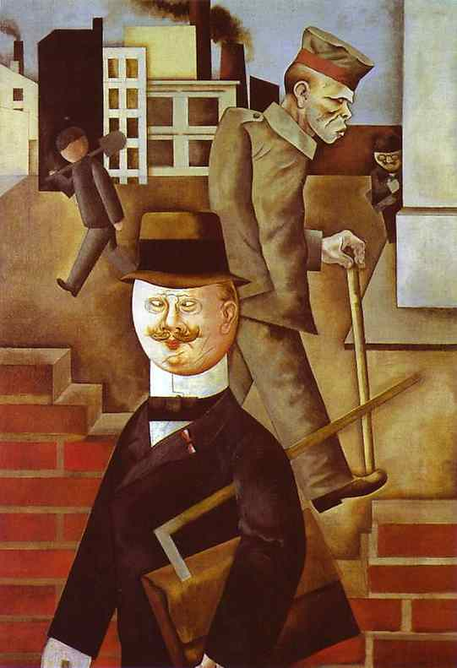
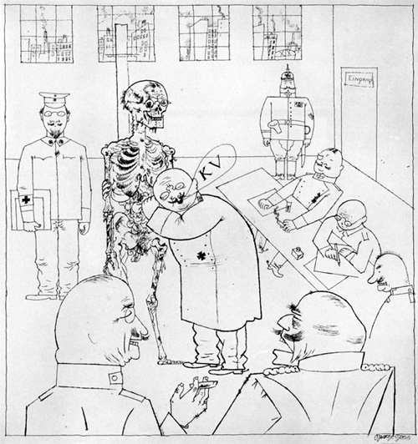
George Grosz (German 1893-1959) (left) Grey Day, 1921, oil on canvas (right) Grosz, Fit for Active Service (The Faith Healers), 1916-17, pen, brush, ink on paper, 20 x 14”, MoMA NYC. The artist is associated with New Objectivity and Berlin Dada movements but can be called a German Expressionist.

Slide 26
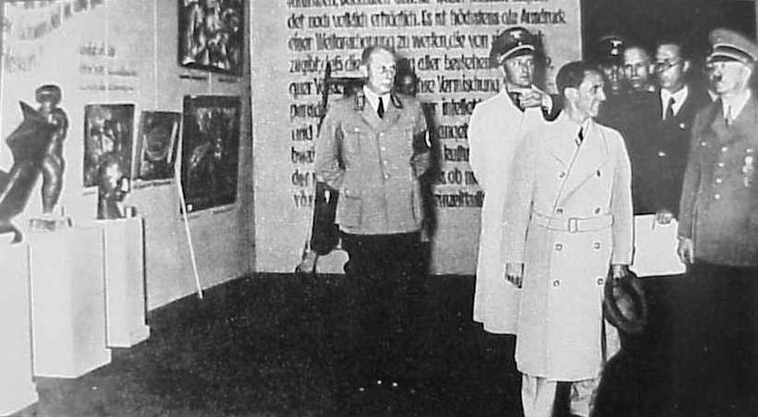
Hitler and Goebbels at the Degenerate Art (Entartete Kunst) exhibition exhibit, featuring over 650 paintings, sculptures, prints, and books from the collections of thirty two German museums, premiered in Munich on July 19, 1937 and remained on view until November 30 before travelling to eleven other cities in Germany and Austria.

Slide 27
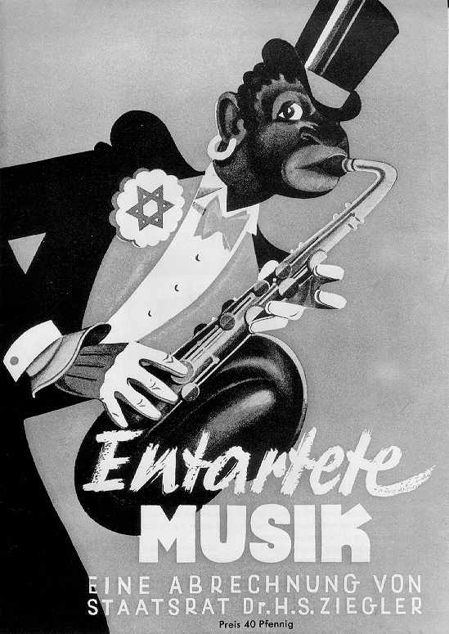
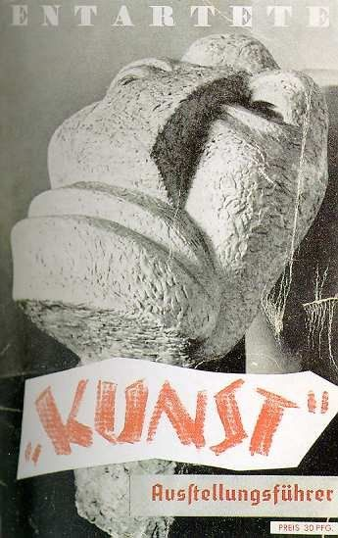
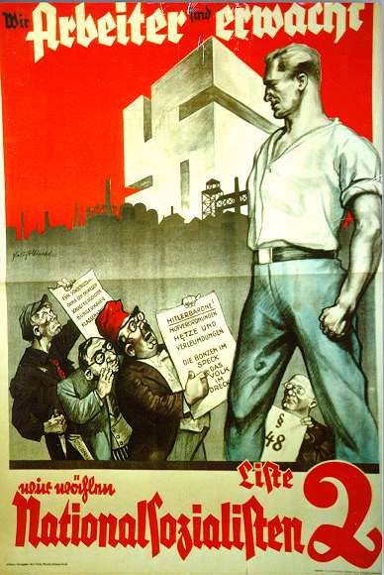

Slide 28
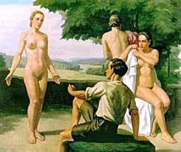
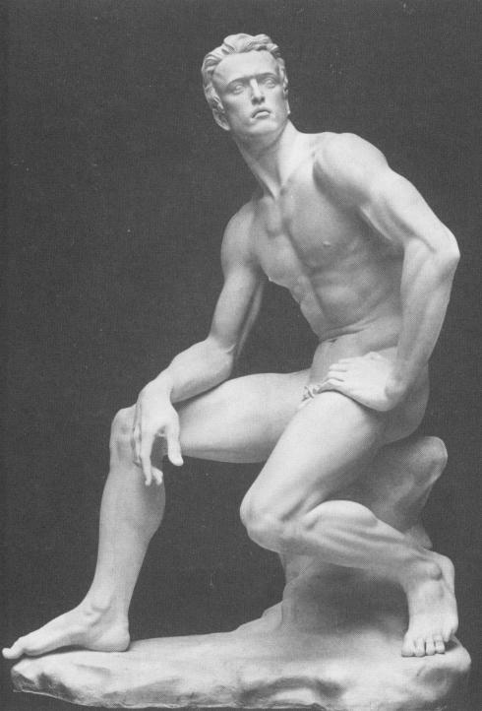
“Good German Art” admired and supported by the National Socialist (Nazi) Party (left) Nazi artist, Ivo Saliger, Judgment of Paris, oil on canvas, Arno Becker, Predestination, 1938 (right)

Slide 29
Adolph Hitler (German 1889 – 1945), Landscape, 1925

